Slide 1

IoT Based Fire Detection System
S.SHALOMSHAN
CSD BATCH:- 08

Slide 2

Introduction
Fire
Proposed Solution
Internet of Things
Fire Detection
Computer Vision
Color Conversion & HSV Color Algorithm
Generate Alert on Fire
Tools & Technology
Conceptual Model
Data Presentation & Analisis
Testing
Advantages of This System
Result
Conclusion

Slide 3
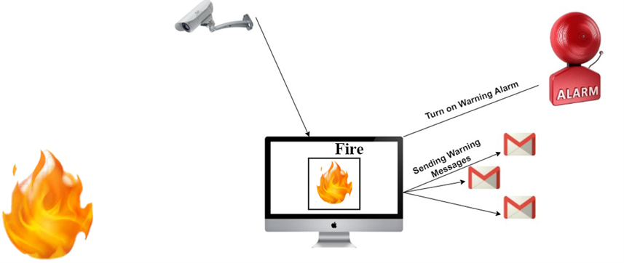
Introduction

Slide 4

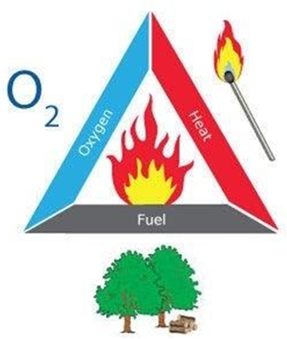
Fire
Fire is the visible effect of the process of combustion- a special type of chemical reaction. It occurs between oxygen in the air and some sort of fuel. The products from the chemical reaction are completely different from the starting material.
The fuel must be heated to its ignition temperature for combustion to occur. The reaction will keep going as long as there is enough heat, fuel and oxygen.

Slide 5
Proposed Solution
IOT based Fire Direction system that has the ability to think and recognize pattern based on experience aka collected data and algorithm that has a heigh probability of resulting in unwanted hazardous fire.

Slide 6
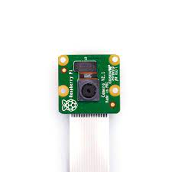
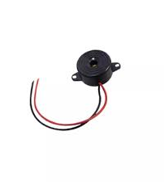
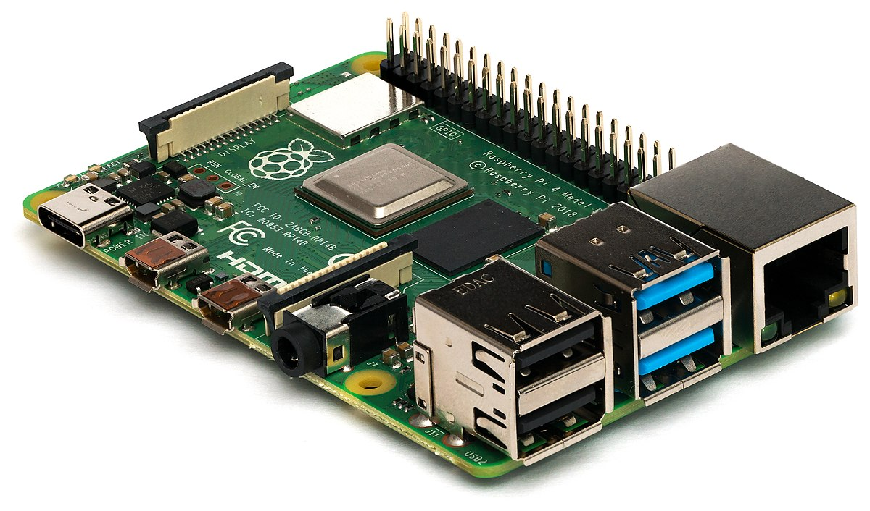
Proposing Fire Detection System Components
Raspberry Pi
Pi Camera
Buzzer

Slide 7

Internet of Things
Internet of things (IoT) is the network of programmable software, sensors, electronics, and communication facility that helps to gather and transfer data.

Slide 8
Fire Detection
The fire detection system is a security system. The primary punction of this system is to detect fires and turn on alarm to warn fire accidents.
This system is written in python with OpenCV computer vision module.
It is using the HSV color algorithm to detect fires.
This system provides a computer vision-based technique for detecting fire and identifying hazardous fire by processing the video data generate by an ordinary camera.

Slide 9

Computer Vision
Computer vision is an interdisciplinary scientific field that deals with how computers can be made to gain high-level understanding from digital images or videos. From the perspective of engineering, it seeks to automate tasks that the human visual system can do.
This Photo by Unknown author is licensed under CC BY.

Slide 10
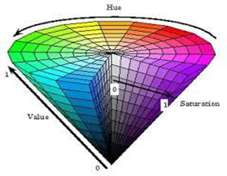
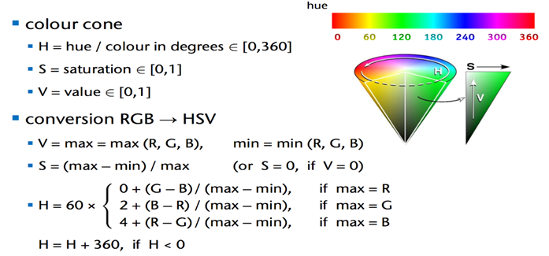
Color Conversion & HSV Color Algorithm

Slide 11
Generate Alert on Fire
The main motive of using this system is to prevent from the loss of life or any other damages to the company or the organization Few years back the system that were installed are now obsolete because they detect fire or smoke when it reaches the maximum level and until that time the loss was already done.
The fire detection system is used to detect fire in air through camera in real time monitoring system based on Raspberry Pi. The main feature of system is to alert generate when fire is started or reached it minimum level to prevent from the loss of lives and damages of any other property or valuable things that are useful for the company or any place where it is installed.

Slide 12



Tools & Technology
Python
OpenCV
HSV Color Algorithm
Anaconda Distribution

Slide 13
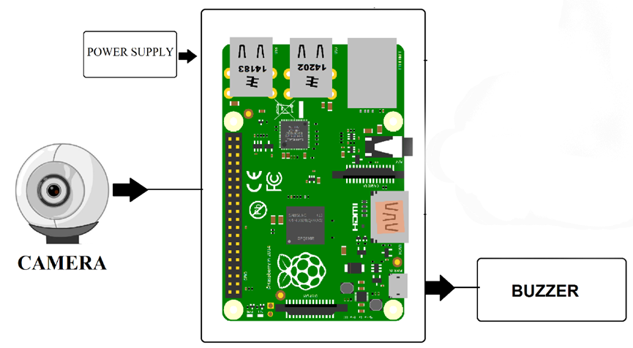
Conceptual Model

Slide 14
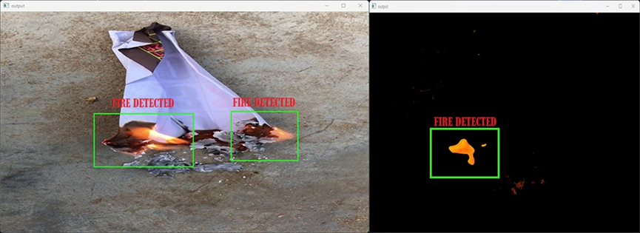
Data Presentation & Analisis

Slide 15


Testing

Slide 16
Advantages of This System
IOT based fire alarm system compared to what is widely deployed right now will be alert faster, in real time.
flames quickly and can analyze location of fire.
In these detectors, flame which is the vision part of the fire can be analyzed via its color shape and movement based on spectral and spatial models, although, vision-based detectors have several advantages, however, false detections limit their utilities.
The reason behind proposing a system of like fire detection is to prevent from the loss and damages done by fire very before by generating an alert.
As the notification system is real time that can cut the response time significantly.
Even when the fire has spread the heat signature collected from the data would enable us to identify how the fire spread and thus give us better insight on how to best deal with it.

Slide 17
Results
The final result of our fire detection system is that it started detecting fire when fire comes up in front of camera and the system is working correctly and without any delay.
We are still working on the system to overcome the false alerts as the system doesn't know the exact shape and color of fire, so it detects the other objects of same color and fire and generate an alert.
We are working on our algorithm and making it more efficient so it can detect the exact shape and color of fire and don't get confused between another shape of other objects and don’t generate false alerts.
The fire detection system is very good approach in modern world so that the losses and damages done by fire before will not be repeated again and no other lives will be harm.
The main advantage of system is that it is portable and can be carry anywhere but very carefully and is very cost effective and is working very well.

Slide 18

IoT is very useful way to detect fire and to detect fire by using computer vision. The idea is that is to give a camera a power of human eye and to detect fire when it starts but that is not a easy job. The researchers then design and implement different algorithms using programming languages and they come up with a algorithm of fire detection using camera but it has some flaws. The algorithm that are design until now are not able to detect fire completely but they also detect some other objects in the color combination of fire and generate a false alarms or notification. The working on it are still going and researchers are working to minimize the rate of false alarms or notifications.

Slide 19


Slide 20

Thank You

